Slide 1
Deconvolution Implementation output and coe generation #8 2019.2.9

Slide 2
Outline
Output generation
Coe generation

Slide 3
Definitions
F₀ F₁ … F_{Np-1} | Np points of piolet observation
C₀ C₁ … | coefficient of output, collected by Y_{F} / Y_{IF}
Y_{F}^{n} | n^{th} received signal, frequency domain, with ICI
Y_{IF}^{n} | n^{th} ICI-free …

Slide 4
Output generation
8 iterations
The output should only do with
and

Slide 5
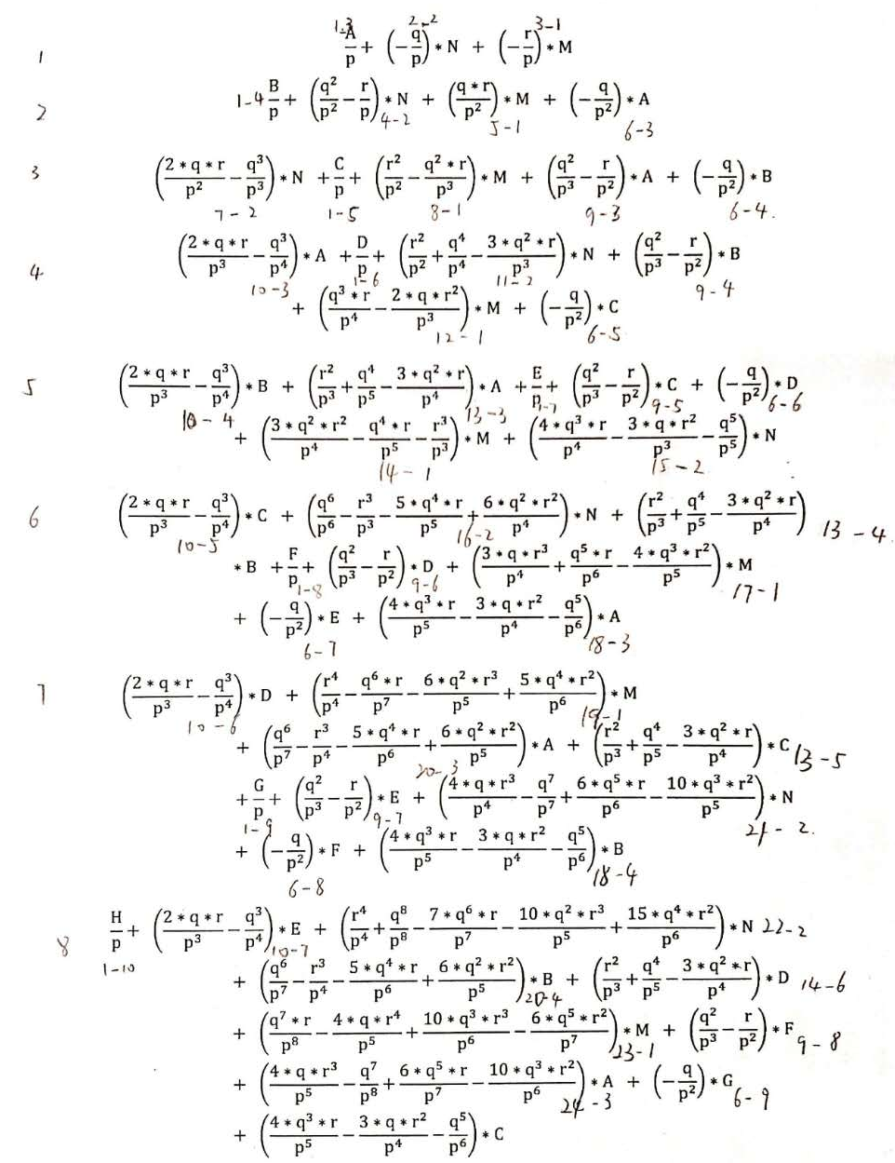
Expand, and collect by
Then we get
M、N means
p、q、r means

Slide 6
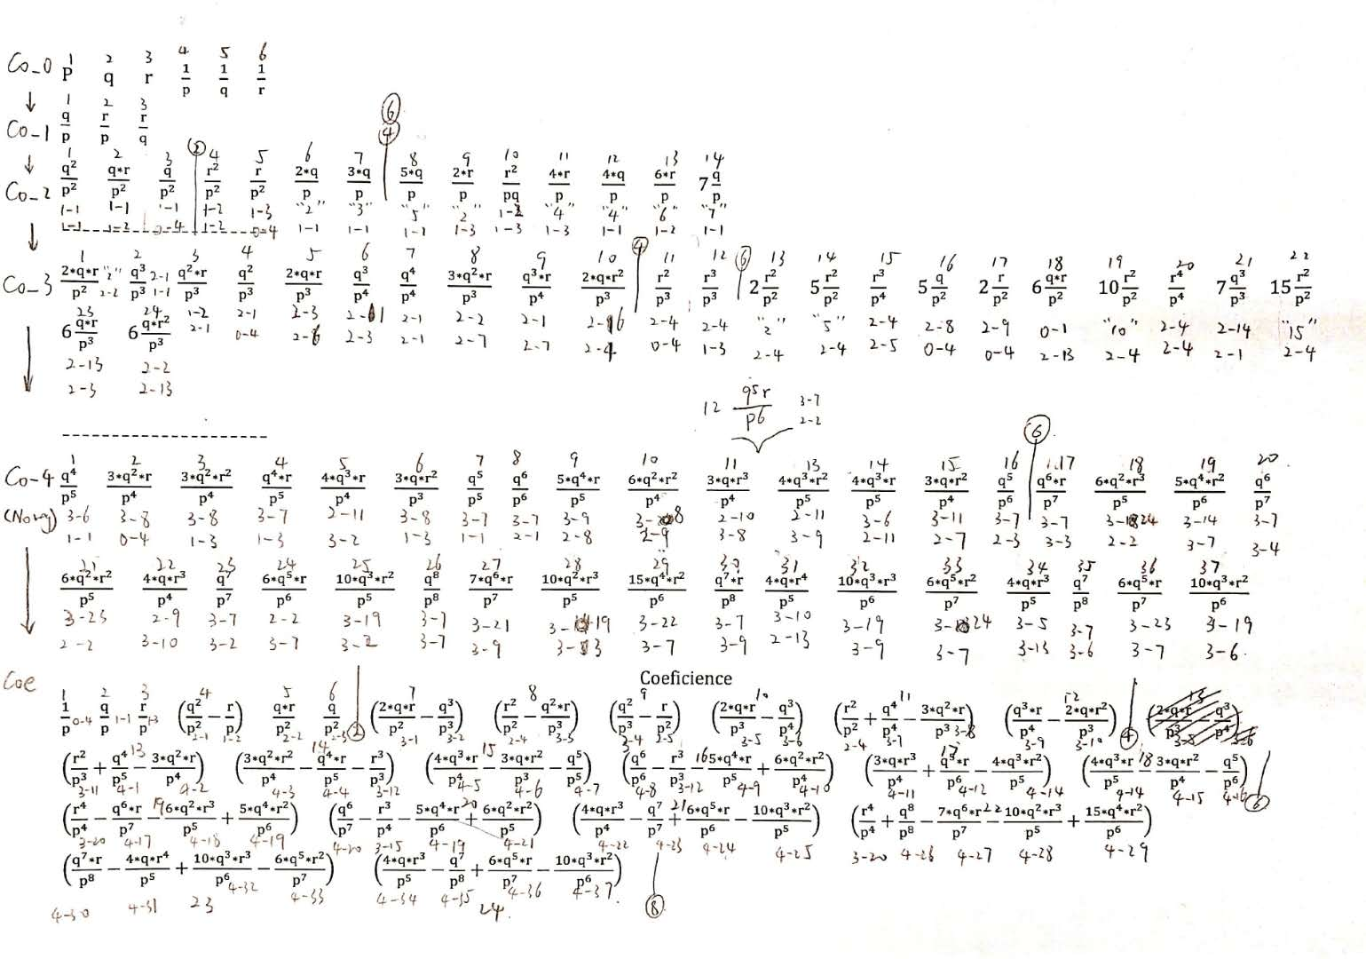
coe generation
We can get coe like below
Where p、q、r means

Slide 7
How to generate the coe in circuit
For every coe, we should design respectively.
How to generate e.g. ?
ans. Generate and respectively and then sub.

Slide 8
How to generate the coe in circuit
Then how to generate and ?
ans.
generate in the first and second cycle.
Generate and in the third cycle
Generate in the fourth cycle.
Wait for other coe to finish generation and add/sub
in the fifth(last) cycle

Slide 9
How to generate the coe in circuit
Similar as the analysis above, we separate the generation process to groups, according to the cycles it need to finish generation.
Every coe needs to be considered.

